Slide 1



MS Access
Class VIII
lab 29

Slide 2

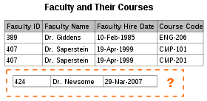
Normalization
Database normalization, or simply normalization, is the process of organizing columns (attributes) and tables (relations) of a relational database

Slide 3
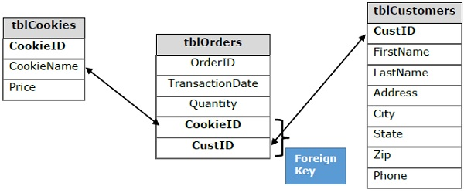
Table Breakdown

Slide 4
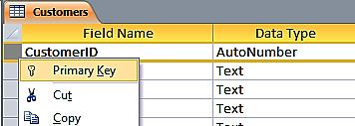
Defining Relationships
the relationship matches the primary key from one table, which provides a unique identifier for each row, with an entry in the foreign key in the other table

Slide 5
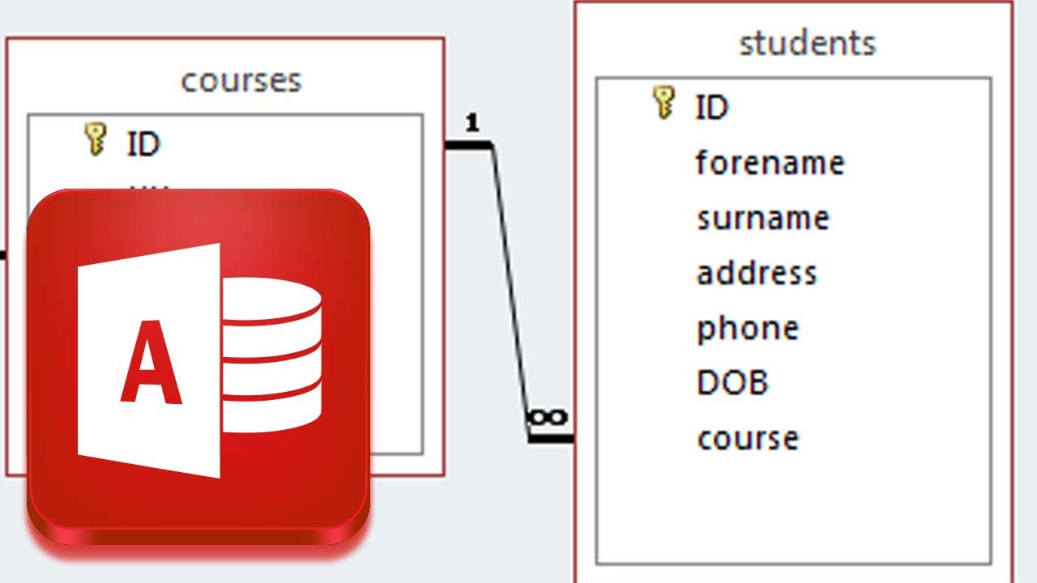
One-to-Many Relationships
a row in table A can have many matching rows in table B, but a row in table B can have only one matching row in table A

Slide 6
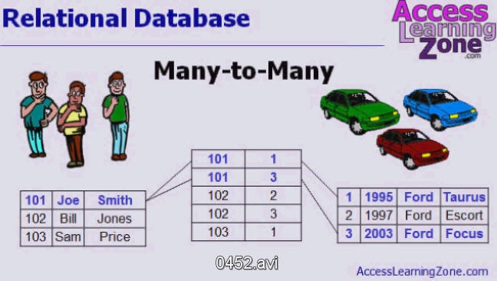
Many-to-Many Relationships
a row in table A can have many matching rows in table B, and vice versa

Slide 7

One-to-One Relationships
a row in table A can have no more than one matching row in table B

Slide 8



